Slide 2
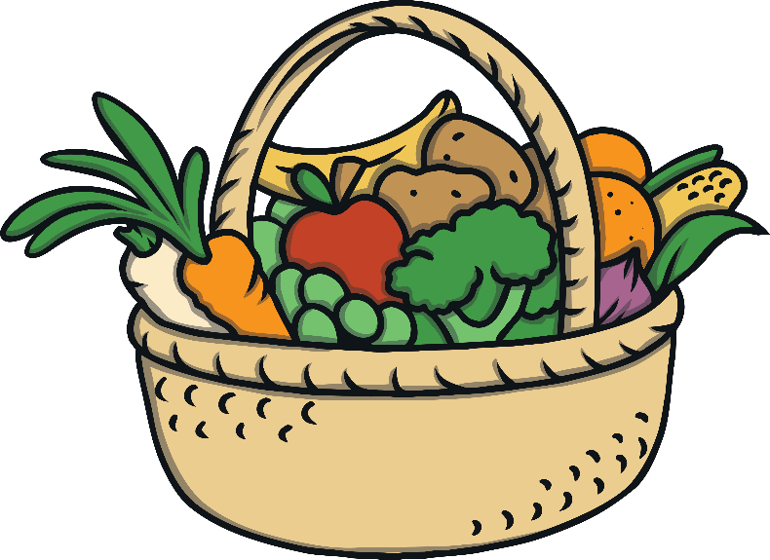
What is Harvest Festival?
A harvest festival is a celebration of the food that is grown on the land.
Celebrations giving thanks for our food, happen in many countries around the world.
In Britain, harvest festivals are often celebrated in churches by bringing baskets of food to give thanks to God. People enjoy singing, praying, listening to stories and decorating the church.

Slide 3
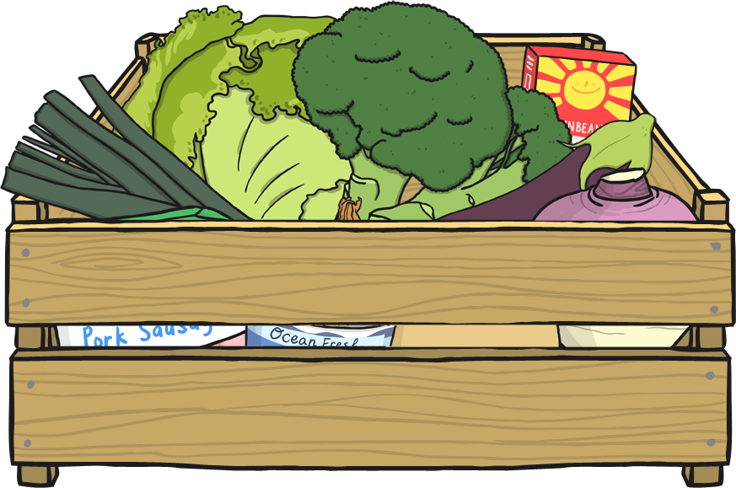
Harvest in the Past
In the past, it was not as easy to find food in the winter. It was important that farmers brought the harvest in before the cold winter came so that there was enough food until the spring.
Now, we bring food in from all around the world. Fruits and vegetables are available for us to buy at all times of the year.
Harvests all around the world allow us to enjoy different foods at any time of year.

Slide 4
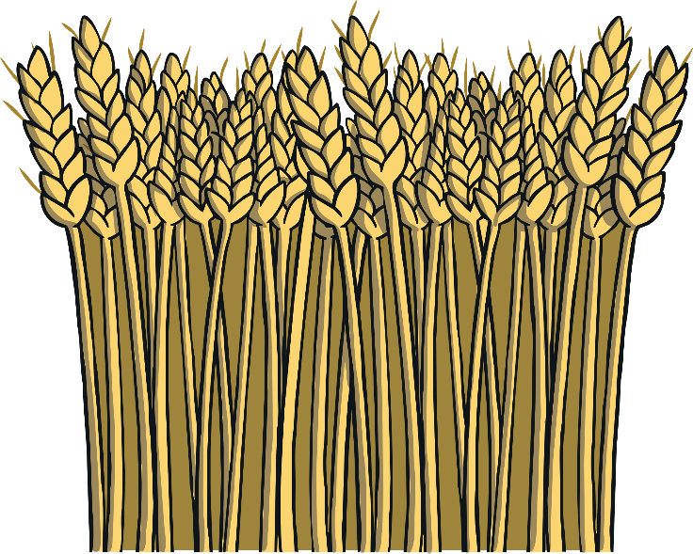
Why is Harvest Celebrated?
Harvest is celebrated to give thanks for the crops, which have been safely harvested.
Christians thank God for the food during harvest.
Christians believe God made the world and everything in it.
Christians also thank God for the variety of food and everything that helps the food to grow.

Slide 5
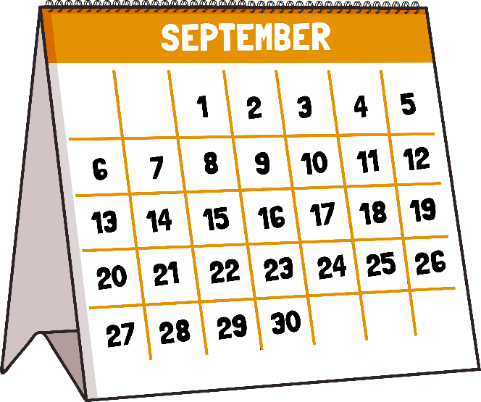
When is Harvest Festival?
In Britain, harvest festivals are traditionally held on or near the Sunday of the harvest moon.
This is the full moon that happens closest to the autumn equinox (around the 23rd September).
This is usually in September, although in some years it is October.

Slide 6
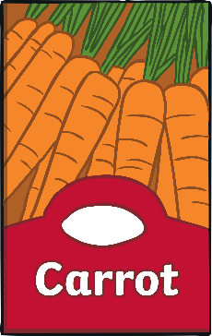
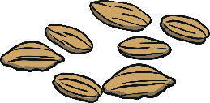
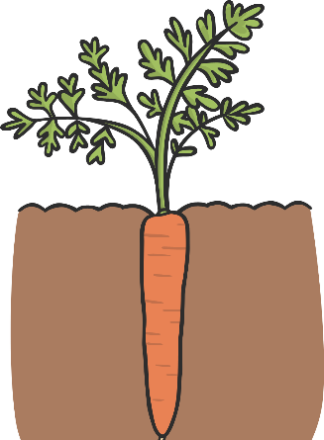
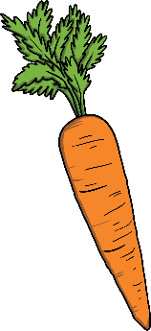
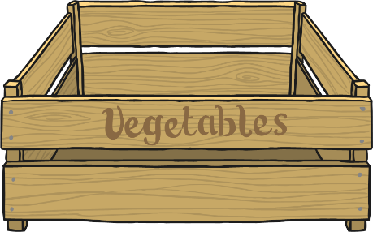
How Do We Harvest Our Food?
Before we can harvest our food, we need it to grow.
The seeds are planted and the food begins to grow.
The plants grow bigger and if they have fruit, it starts to ripen.
When the plants are ready to be harvested, the farmer collects the grains, fruit and vegetables, ready for us to eat.

Slide 7
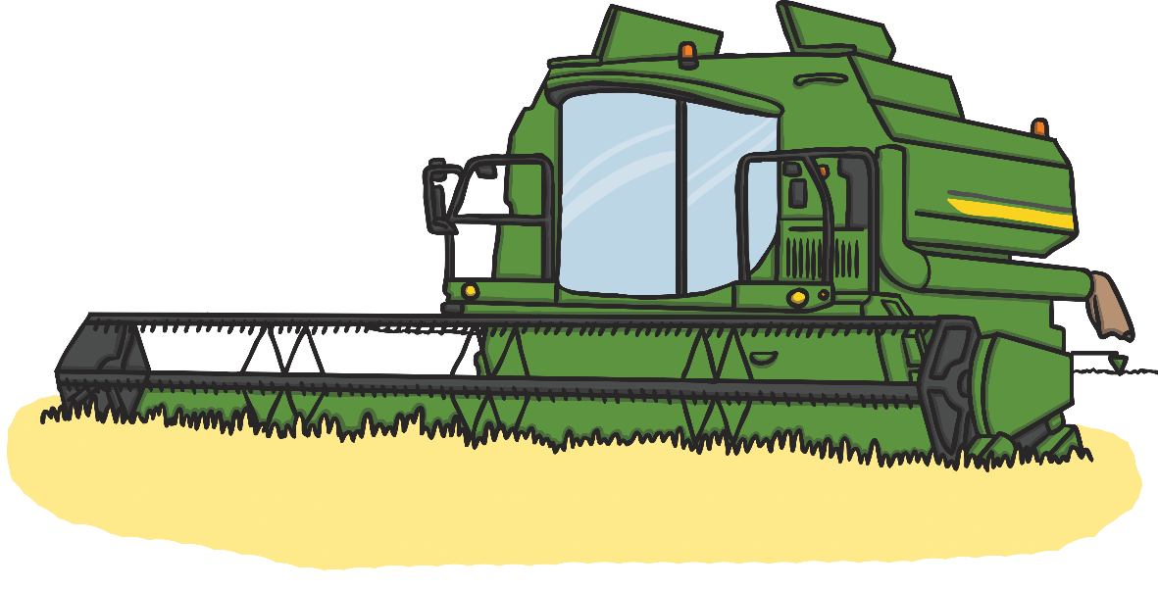
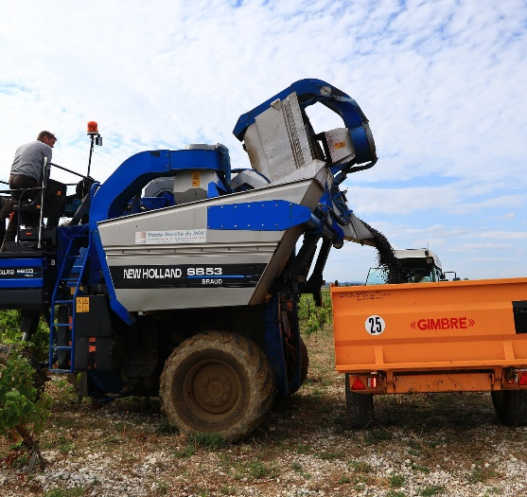
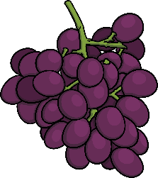
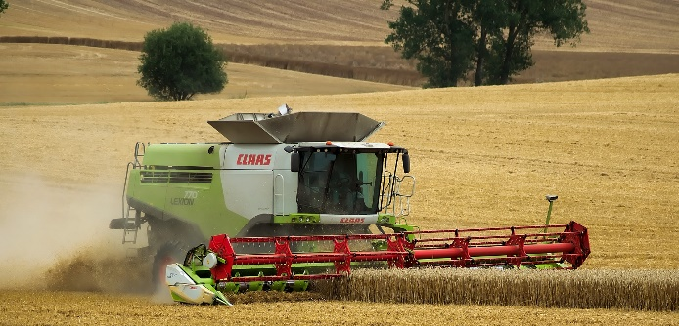
How Do We Harvest Our Food?
Machinery
Farmers use machinery to harvest some of their crops. The machines are big and able to harvest the grains, fruits or vegetables much quicker than by hand.
This wheat is being harvested using a combine harvester.
This machine is carefully harvesting grapes.

Slide 8
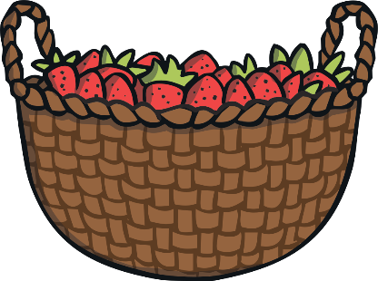
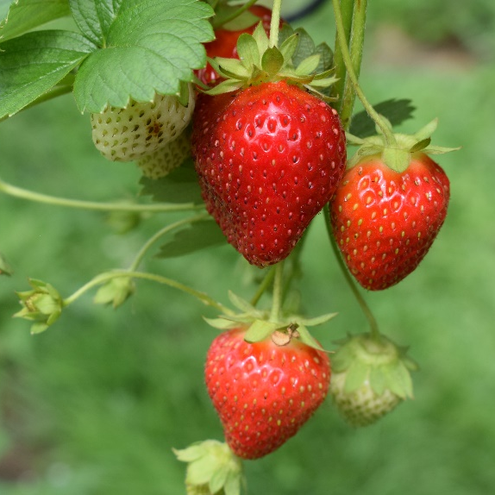
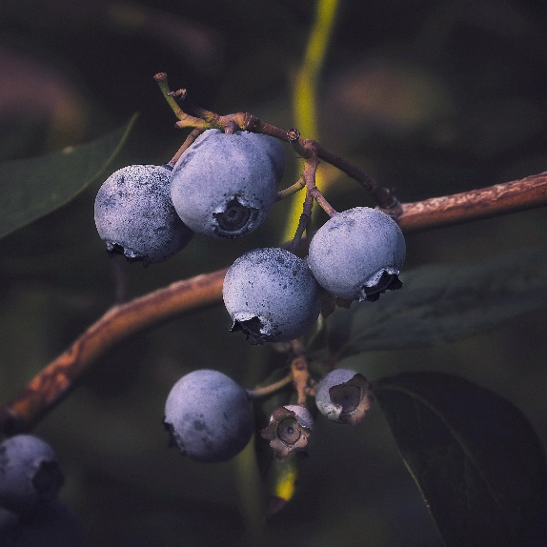
How Do We Harvest Our Food?
By Hand
Some fruits and vegetables are too delicate to be harvested by a machine. They need to be carefully picked and stored so that they don’t get damaged.
Strawberries
Blueberries
Vanilla

Slide 9
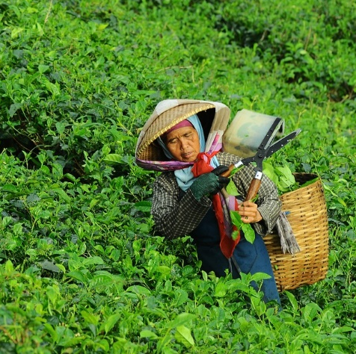
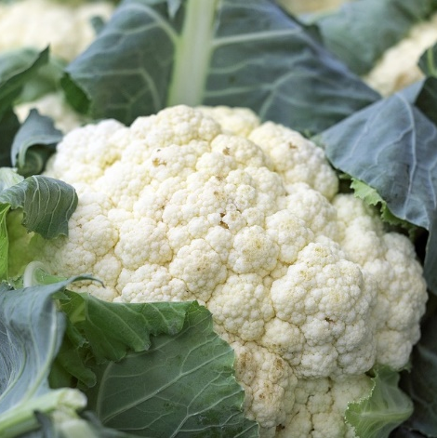
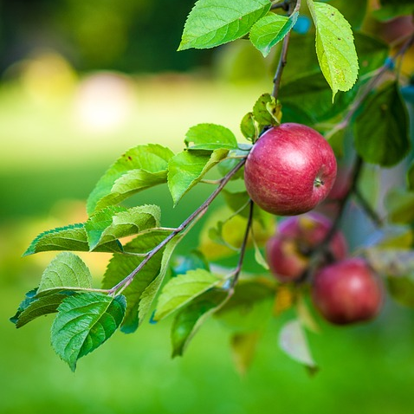
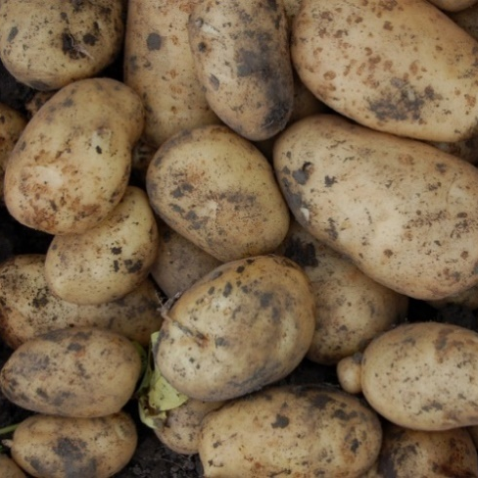
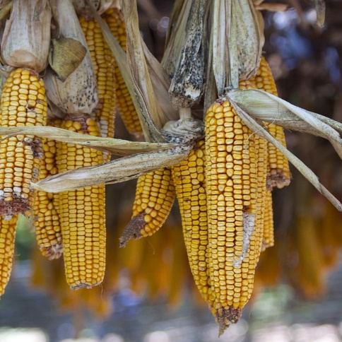
How Will These Foods Be Harvested?
Tea
by hand
Cauliflower
by machine
Apple
by machine
Potatoes
by machine
Cocoa
by hand
Corn
by machine

